Slide 1
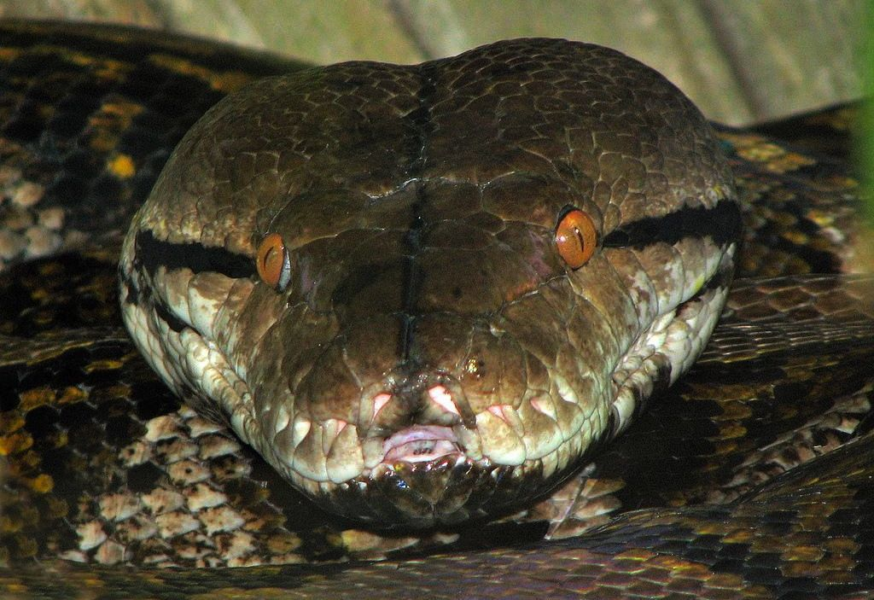
CHAPTER - 10 OPERATORS AND EXPRESSIONS

Slide 2
Unit 2:
XI
Computer Science (083)
Board : CBSE
Computational Thinking and Programming
Courtesy CBSE

Slide 3
CHAPTER - 02 OPERATORS AND EXPRESSIONS

Slide 4
INTRODUCTION

Slide 5
OPERATORS

Slide 6
OPERATORS
What is an operator?
Operators are tokens that trigger some computation when applied to a variable.
What is Unary Operator?
Unary operators are those operators that require one operand to operate upon.
Unary Operators:
+ Unary Plus
- Unary Minus
~ Bitwise Compliment
not Logical Negation

Slide 7
OPERATORS
What is Binary Operator?
Binary operators are those operators that require two operands to operate upon.
Binary Operators:
+ Addition
- Subtraction
* Multiplication
/ Division
% Remainder or Modulus
** Exponent.
// Floor Division

Slide 8
OPERATORS
What is Binary Operator?
Binary operators are those operators that require two operands to operate upon.
Binary Operators:
+ Addition
- Subtraction
* Multiplication
/ Division
% Remainder or Modulus
** Exponent.
// Floor Division

Slide 9
OPERATORS
Bitwise Operators:
& Bitwise AND
^ Bitwise Exclusive OR
| Bitwise OR
Shift Operators:
<< Shift Left
>> Shift Right

Slide 10
OPERATORS
Relational Operators:
< Less than
> Greater than
<= Less than equal to
>= Greater than equal to
== Equal to
!= Not equal to
Logical Operators:
and Logical AND
or Logical OR

Slide 11
BINARY OPERATORS EXAMPLE

Slide 12
BINARY OPERATORS EXAMPLE

Slide 13
BINARY OPERATORS EXAMPLE
Exponent
Floor Division

Slide 14
BITWISE OPERATORS EXAMPLE

Slide 15
BITWISE AND & EXAMPLE

Slide 16
BITWISE AND & OPERATOR EXAMPLE
& operator picks bits exists in both the operands (common)
BITWISE AND OPERATOR

Slide 17
BITWISE OR | EXAMPLE

Slide 18
BITWISE OR | OPERATOR EXAMPLE
| operator picks bits exists in either the operands ( any one or both )
BITWISE OR | OPERATOR

Slide 19
BITWISE OR EXCLUSIVE ^ EXAMPLE

Slide 20
BITWISE EXCLUSIVE OR ^ OPERATOR EXAMPLE
It picks up bit if it is one operand not in both (uncommon)
BITWISE ^ OPERATOR

Slide 21
SHIFT OPERATORS EXAMPLE

Slide 22
BITWISE ONE’s COMPLIMENT
~ OPERATOR EXAMPLE

Slide 23
BINARY ONE’s COMPLIMENT ~ OPERATOR EXAMPLE
It is the unary operator which has a flipping effect.

Slide 24
<< BINARY LEFT SHIFT
OPERATOR EXAMPLE

Slide 25
BINARY << LEFT SHIFT EXAMPLE
The first operand’s value is moved left by the number of bits specified by the second operand.

Slide 26
<< BINARY RIGHT SHIFT
OPERATOR EXAMPLE

Slide 27
BINARY >> RIGHT SHIFT EXAMPLE
The first operand’s value is moved right by the number of bits specified by the second operand.

Slide 28
Assignment Operators

Slide 29
OPERATORS
Assignment Operators:
= Assignment Operator
*= Assign Product
/= Assign Quotient
+= Assign Sum
-= Assign Minus
%= Assign Remainder
**= Assign Exponent
//= Assign Floor Division.

Slide 30
DIFFERENT ASSIGNMENT
STATEMENT EXAMPLE

Slide 31
BINARY >> RIGHT SHIFT EXAMPLE

Slide 32
OPERATORS
Membership Operators:
in weather variable in sequence.
not in weather variable not in sequence

Slide 33
MEMBERSHIP OPERATOR
EXAMPLE

Slide 34
MEMBERSHIP OPERATOR EXAMPLE

Slide 35
CLASS TEST

Slide 36
CLASS TEST
Time: 40 Min Max Marks: 20
What is an operator? Explain 05
2. Explain bitwise operators 05
3. What is assignment statement? What are the different types of assignment operators? 05
4. Explain membership operators 05

Slide 37
Thank You

